Slide 1

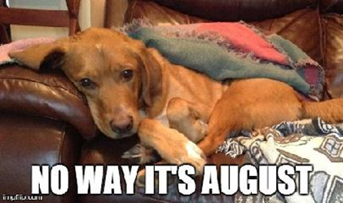

Welcome to 8th grade science

Slide 2
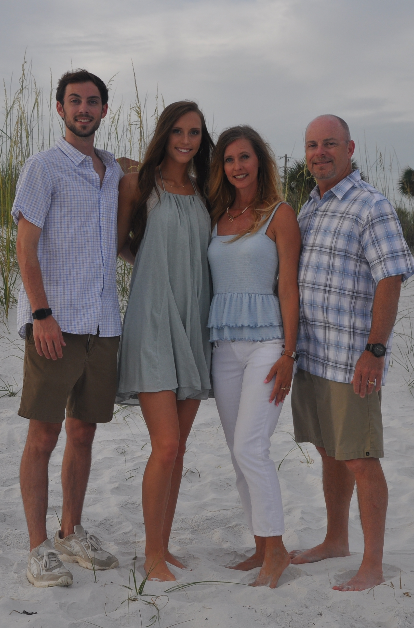
A little bit about me (Mrs. Meek)
This is my 18th year teaching and this is my 2nd year at CMS. I am the 8th grade Science Teacher. I have taught Physical Education, Science, and Social Studies.
A little about my family:
I have a son who graduated from the University of Tennessee at Chattanooga. He earned his BS in Marketing.
I have a daughter who is a Senior at MTSU. Her major is Equine Science and she is working on a double minor in Chemistry and Biology. (those ACT scores and AP classes pay off!)
My husband works at MTSU. We have been married 30 years!
My husband and I are also the Middle School Golf Coaches!
I have 2 horses and 1 dog.

Slide 3
Bell schedule
M & W
1 st Period 8:00 – 9:35 95 minutes
CT 9:40 – 10:40 60 minutes
Club Time/AA 10:45 – 11:15 30 minutes
2 nd Period 11:20 – 1:25 125 minutes
Group A Lunch 11:20 – 11:45
Group B Lunch 11:45 – 12:10
Group C Lunch 12:10 – 12:35
Group D Lunch 12:35 – 1:00
Group E Lunch 1:00- 1:25
3 rd Period 1:30 – 3:00 90 minutes
F
1 st Period 8:00 – 8:55 55 minutes
2 nd Period 9:00 – 9:47 47 minutes
3 rd Period 9:52 – 10:39 47 minutes
4 th Period 10:44 – 11:31 47 minutes
6 th Period 11:36 – 1:16 100 minutes
Group A Lunch 11:36 – 12:01
Group B Lunch 12:01-12:26
Group C Lunch 12:26 -12:51
Group D Lunch 12:51 - 1:16
5 th Period 1:21 – 2:08 47 minutes
7 th Period 2:13 – 3:00 47 minutes
T & Th
4 th Period 8:00 – 9:40 100 minutes
5 th Period 9:45 – 11:15 90 minutes
6 th Period 11:20 – 1:25 125 minutes
Group A Lunch 11:20 – 11:45
Group B Lunch 11:45 – 12:10
Group C Lunch 12:10 – 12:35
Group D Lunch 12:35 – 1:00
Group E Lunch 1:00- 1:25
7 th Period 1:30 – 3:00 90 minutes

Slide 4
Sign-out code for ct, Directed studies, clubs, and advisory
There is a QR code by the exit door you need to open on your phone before you leave to go see another teacher during one of these class periods.
The QR code will open a form. You will need to answer all the questions on the form so I will know where you are and if you will be returning to me during that classtime.

Slide 5
What are we going to learn about this year?
1st 9 weeks
8.PS2.3 Position, forces, and direction (velocity and acceleration)
8.PS2.4 Newton’s Second Law
8.PS2.5 Newton’s Third Law
8.PS4.1 Basic properties of waves
8.PS4.2 Mechanical waves and electromagnetic waves
8.PS4.3 Waves and communication systems
8.PS2.2 Non-contact forces
8.PS2.1 Magnetism and electricity
2nd 9 weeks
8.ETS1.1 Optimal solution design: electromagnets
8.ESS1.1 The universe and its stars
8.ESS1.2 Gravity, celestial motion, and tides
8.ETS1.2 Technology, the solar system, and the universe
8.ESS2.2 Seismic waves and Earth’s structure
8.ESS2.4 Plate movement and convection cycles
8.ESS2.5 Processes of plate tectonics
8.ESS3.2 Natural hazards: volcanoes and earthquakes
3rd 9 weeks
8.ESS2.3 Rocks: processes and forces
8.ESS3.1 Tectonic plates and resource distribution
8.ESS2.1 Biogeology: extinction events
8.LS4.1 Fossil record
8.LS4.2 Evidence of common ancestry
8.LS4.3 Phenotypic variation
4th 9 weeks
8.LS4.4 Natural selection
8.LS4.5 Technology and artificial selection
Review Testing
State Testing
STEM Investigations/End-of-Year Activities
A complete syllabus can be found on my website

Slide 6

Where to find daily activities?
You will be able to find all our activities on my webpage under the SNB TOC (Science Notebook Table of Contents).
Most of our activities will be completed on paper and turned in to the appropriate box for your class period. We will also use TEAMS for some of our activities.
Always make sure to click the turn in button on TEAMS when your activity is complete!

Slide 7
Supplies for class/labs
You will need a 1 ½ - 2 inch binder with 5 dividers for class.
I will let you know 2 weeks before a lab if you will need to bring in any supplies. I try to use recycled materials for labs as much as possible. (cereal boxes, paper towel and toilet paper cardboard rolls, plastic bottles, etc.)
I do know each child will need baggie of old broken crayons with the paper off by December/January.

Slide 8
Grades
Grades will be based on a point system. The categories for grades are as follows:
Classwork
Homework
Projects
Quizzes
Tests

Slide 9
Science Tests
Science tests will be given through Masteryconnect. You will be able to log in through clever.
Each test will be open for you to take during your scheduled class time.
Retakes will be given one week from the original test. Please contact me if you plan to retake a test. I will use the highest score for your final test grade.
Retake activities MUST be completed and turned in before you will be allowed to retake the test.

Slide 10
Textbook
You will have a textbook for class as well as access to it online. You can get access through clever. The username should be your regular username for school. Your password is your last name in all capital letters. (MEEK)
Please only bring the textbook to class when it is requested. You DO NOT have to bring it everyday. I will let you know ahead of time if you need it.
You are encouraged to use the textbook for standards you are struggling with or want more information about.

Slide 11
Entering and Leaving my classroom
Please enter/exit through the appropriately marked door.
Pick up any handouts in the trays by the entrance when you enter the room.
Sit in your assigned seat.
I will dismiss you when class is over and all lab areas are cleaned up.

Slide 12
Codes/Drills
Code Red: Hide under lab table or behind lab table. No cell phones out. Stay quiet until released from code red.
Code Yellow: Doors shut and continue working. No one is allowed to leave the room. Stay in room until released from code yellow
Code Green: Return to normal activity after 2 voices over the intercom tell us to move to code green.
Fire drill: Quietly line up at the door and exit down the stairs at the end of the hall by middle school drop off. Line up in the grassy area across the parking lot and I will take attendance.
Tornado drill: Quietly line up at the door and go to the hallway to the area at the end and they will tell you where to sit.
Evacuation: Listen for directions.
NO CELL PHONES OUT FOR ANY DRILLS

Slide 13
Cover Syllabus items not mentioned above

Slide 14
Stations (use hand sanitizer when you get to a new station if there are shared items.)
Lab Tables 1 & 2 - Textbook Scavenger Hunt
Lab Tables 3 & 4 - Science Color Sheet
Lab Tables 5 & 6 – TEAMS and Syllabus Questions
Lab Tables 7 & 8 - Investigate the Teacher

Slide 15
Begin stations

Slide 16


10
9
8
7
6
5
4
3
2
1
Move to the next station when the timer stops.

